Slide 1
Rakhimov Orzubek
Full stack developer

Slide 2
Agenda
Kirish
Web dasturlash
Frontend/backend
Backend languages
Framework (Django)
Bozor
Docker
SQL
Powerbi
Telegram bots
Proyekt

Slide 3




Web dasturlash
Internetda ishlaydigan dasturlar yaratish

Slide 4
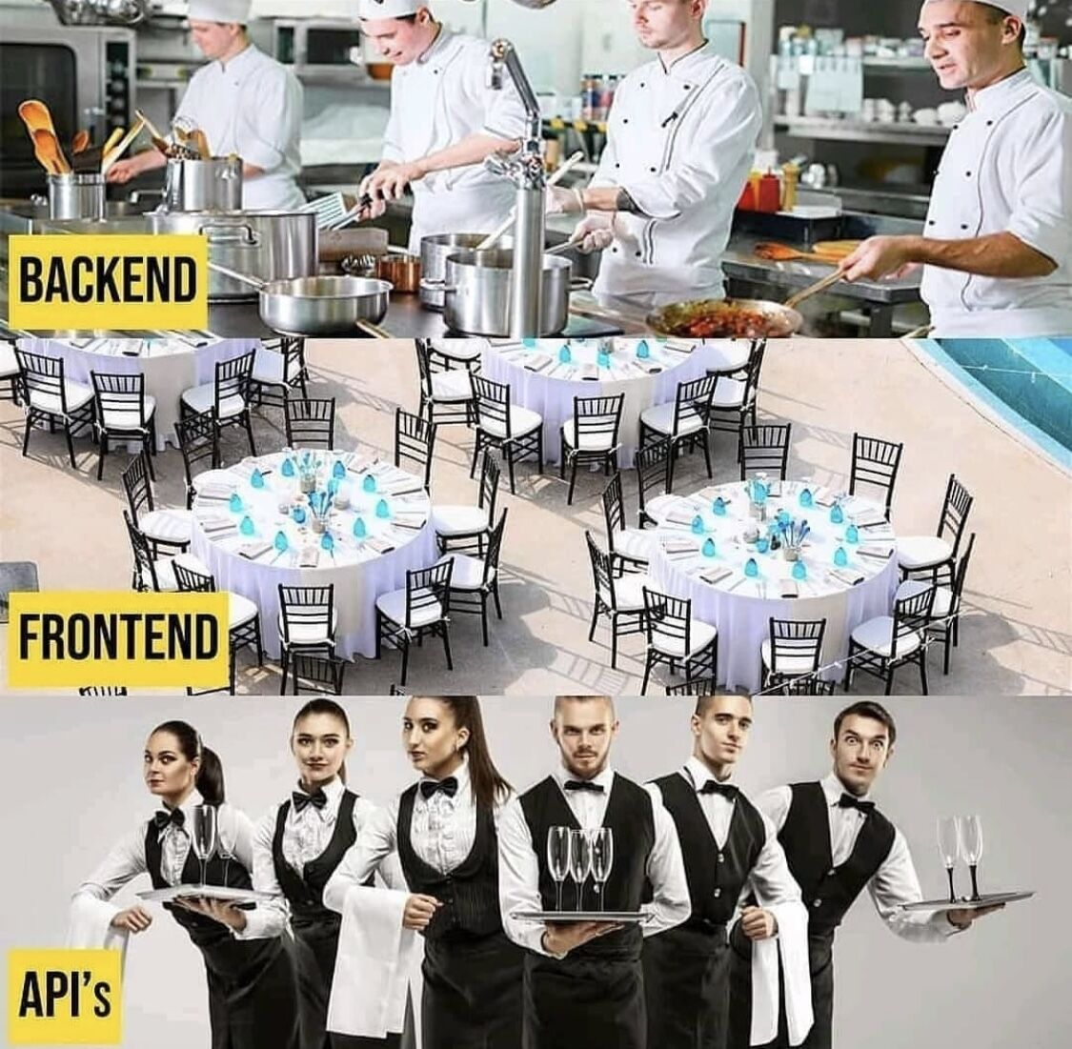
Frontend/backend

Slide 5
Backend languages
Javascript
Java
Python
PHP
Ruby
Rust
C#

Slide 6






Framework - Tayyor kodlar to‘plami

Slide 7
Framework (Django)
Tez
Xafsiz
kuchli
Ai integratsiya
Auth/Admin/ORM

Slide 8
Framework
Biznes logika:
  Django - views
  Laravel - controllers
  Express - handlers
  Model:
  ORM,Validatsiyalar,relations
  Config:
  Sozlamalar, Env o’zgaruvchilar
  Middlewares:
  Biznes logikadan oldin yoki keyin ishga tushuvchi funksiya
  Auth,Logging,Pernissions
  Security/Utilis:
  Authentication, CSRF, Validation, Error handling

Slide 9
Framework
User request -> Router -> Middleware -> Controller/View -> Database/Model -> Response

Slide 10
Bozor
Talab katta
Masofadan ish
Freelance imkoniyatlari
Startup
Bank
E-commerce
Telegram botlar

Slide 11
Bozor
Jahon bozorida
70-90k/100-130k/140-180k
Uzbekistan
8-15k/18-30k/35-60k
Linkendln 150 000
Indeed 120 000
Glassdoor 60 000
Remote 20 000

Slide 12

Docker
Docker siz:
Bir kompyuterda ishlidi
Boshqasinda yo’q
Xa rxil kutubxona va os
Docker:
bir xil dastur sharoit
oson setup
tez deploy atish

Slide 13
Docker
Image
  Blueprint
Container
  Proekt/virtual prosses
Dockerfile
  Instruksiya
Docker compose
  bir nechta servislarni birgalikda harakata apkaladi

Slide 14

SQL-Structured Query Language
Xotira
databaza bn aloqa
users,products,orders
x - data lost, no structure , no search
USERS
------------------------
id | name | email | age

Slide 15


Powerbi/Telegram bots
Vizuallashtirish
Tartiblash
Biznesni osonlashtirish
Bot
Auto xarakat qiluvchi botlar

Slide 16
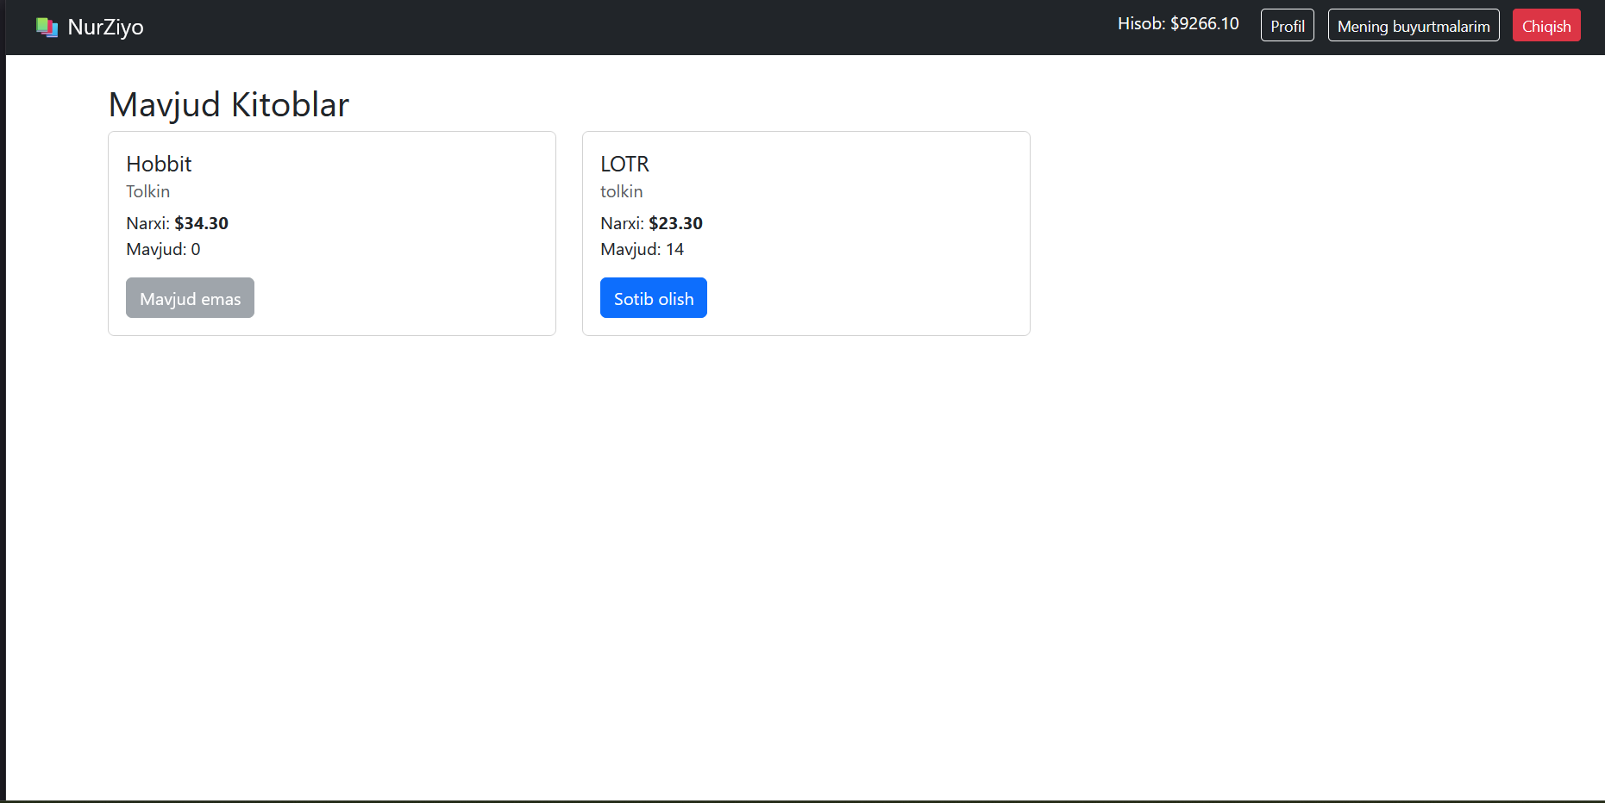
Proyekt

